Slide 1
Internal Control Review Proposal

Slide 2
Our team of professionals at TRS Forensics Pte Ltd is highly skilled in the nuances of Risk Advisory, Process Reviews and Internal Audit.
Combined with our Forensic Technology and Cybersecurity capabilities, we offer a unique proposition for the Internal Audit process by tapping on data analytics to elevate the accuracy and efficiency of the review process, unlike the traditional approach. By conducting a robust review of the current internal process, we can help your organisation mitigate potential losses arising from operational and compliance issues.

Slide 3
Your Objectives

Slide 4
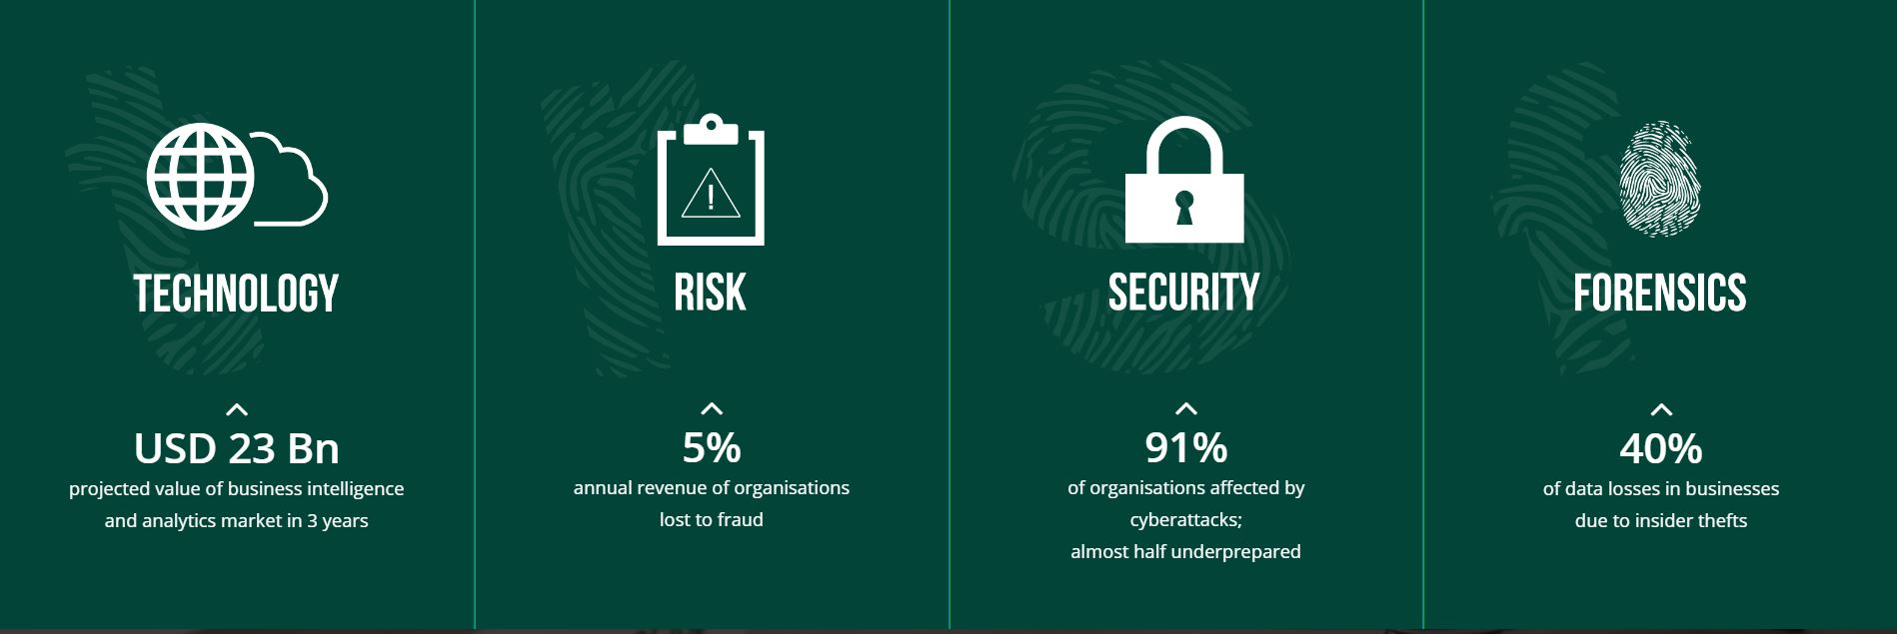
Our Services

Slide 5
TRS adopts a robust and comprehensive Internal Control Review process which is in line with the International Standards for the Professional Practice of Internal Auditing. Our review covers financial and non-financial risk areas and ensure compliance with applicable rules and regulations and best practices in different jurisdictions.
We are client-centric, apply commercial sense in our reviews and provide practical and cost-effective recommendations to our clients.
What We Offer

Slide 6

In a competitive and increasingly complex business environment with greater use of computers and digitalisation, our cybersecurity and data analytics solutions enable us to identify and analyse IT security lapses and fraud indicators in a timely manner.
Our service offerings are comprehensive and go beyond the traditional internal control review processes. By tapping on our extensive experience in audit and forensics, we are able to deploy the right tools and right people should the need arise and respond promptly.
What We Offer

Slide 7
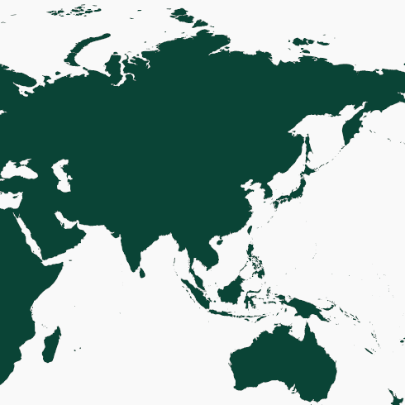

Our Presence
We have offices and professional staff based in Singapore and Malaysia. Our Shanghai office is planned to be ready by 2019.

Slide 8


Our Risk & Technology Management Team
Gary Ng
Director
Gary, a Certified Internal Auditor and Chartered Accountant of Singapore, has over a decade of experience relating to risks and internal controls. He has advised many companies from various industries, including those preparing for IPOs in Singapore and Hong Kong.
As a Singapore Certified Management Consultant, Gary is able to assist companies in various grant applications under Enterprise Singapore.
Derek Kiong
Director
Derek has over 30 years working with systems software including software to build/run software. He has also taught software development in undergraduate in NUS and post-graduate courses in Institute of Systems Science.
Derek is an appointed member of IMDA CITREP+ Skills Expert Panel, Security and Software & Applications domains

Slide 9
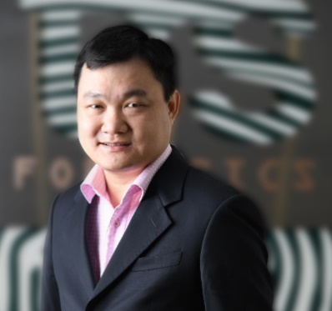
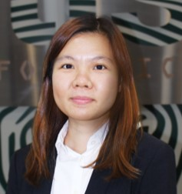
Our Risk & Technology Management Team
Tan Kah Leong
Director
Kah Leong is an Encase Certified Examiner and Trainer, Magnet Certified Forensics Examiner and Trainer, and Tenable Certified Nessus Auditor (TCNA).
His extensive Forensic Technology skills include developing new methodology to review OS and application artifacts from user-related activities, and providing affidavit and acting as an expert witness in court.
Priscylia Wu
Assistant Director
Priscylia is admitted as an Advocate and Solicitor of the Supreme Court of Singapore. She previously practised in the dispute resolution departments of some of the largest law firms in Singapore.
Priscylia has previously advised and represented a wide range of clients, including MNCs, listed companies and SMEs, in the areas of contracts, shareholders’ disputes, fraud, regulatory requirements, criminal investigations etc.

Slide 10






Our Unique Proposition
Synergising Capabilities
Forensic Accounting
Forensic Technology
What differentiates TRS Forensics from our competitors is our ability to synergise our combined experience in risk advisory, forensic investigation, forensics technology and cybersecurity to provide our clients with services tailored to meet the modern business environment and challenges.
Tax Compliance
Data Analytics
Internal Control & Process Review
Internal Control and Process Review
PDPA
Internal Control and Process Review
VAPT
AML
AML
Cybersecurity
Our forensics technology and forensics accounting expertise, coupled with powerful data analytic tools, enable us to identify and analyse fraud indicators in your business processes and verify if there are potential fraudulent activities such as misappropriation of funds in a timely manner.

Slide 11
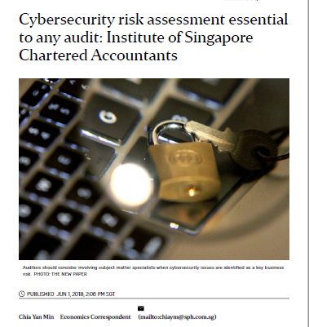
Cyber Security Assessment
Forensic Accounting
Forensic Technology
Background
“Cyber criminals have evolved from targeting computer systems and networks to breaching buildings, factories and safety controls systems through the embedded computer and communication chips”
“…cyber risks are becoming pervasive and are causing an impact on financial line items treatment. This would need to be considered when we perform financial statement audits.”
Tax Compliance
Data Analytics
Internal Control & Process Review
Internal Control and Process Review
PDPA
Internal Control and Process Review
VAPT
AML
AML
Cybersecurity
AML
Impact on Audit
“Auditors should take cybersecurity risks into account for every audit - even when the company under audit has no online presence”
“While it is not the auditor's responsibility to detect every cyber incident that results in changes to a company's financial records, robust audit procedures have a good chance of picking up unauthorised material changes.”
Extracted on 01 Jun 2018, The Straits Times, “Cybersecurity risk assessment essential to any audit: Institute of Singapore Chartered Accountants”

Slide 12













Our Unique Proposition
What differentiates us from the rest is our ability to offer a full suite of services that are specifically tailored to the modern business environment at all companies.
Data Analytics
The traditional audit approach has been to select and test samples of transactions and applying various sampling methods. At TRS, our work would include these procedures but with the additional deployment of technology and data analytics tools, we are able to work closely with our peers in the technology team to analyse larger volumes of data, detect anomalies and unusual trends in a timely manner and assess how well automated controls, semi-automated control and manual controls are being followed.
Examples of Data Analytics in Action
Procurement to Payment Process – Identification of vendor duplicates and any split payments to vendors to avoid higher authority authorisation
Sales to Collection Process – Trends on pricing and discount rates against company directives
Payroll Process – Duplicate employees, different employees sharing same bank account details and employee bank accounts being same as vendor’s

Slide 13
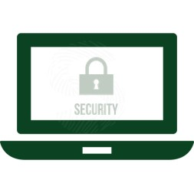
Our Unique Proposition
Cybersecurity Advisory Services
Our team of cybersecurity professionals can assist in assessing and benchmarking client’s cybersecurity posture to be aligned with best practices within the industry.
Our cybersecurity consultants are experienced in designing and deploying systems which are robust and secure from a cybersecurity perspective.
Our Vulnerability Assessment and Penetration Testing (VAPT) procedures tests the effectiveness of cybersecurity defences against hackers and help to identify and address any vulnerabilities in systems before an attacker does.

Slide 14

Our Unique Proposition
Data Protection Trustmark Certification
The DPTM Certification is based on Singapore’s Personal Data Protection Act (PDPA) and incorporates elements of international benchmarks and best practices.
It validates our adoption of robust and responsible data protection practices and demonstrates our commitment to safeguarding and protecting data.
Companies that are DPTM-certified have been subjected to a rigorous assessment of their data governance and protection practices and verified to be compliant.
As the first technology and risk advisory firm in Singapore that is DPTM-certified, we give confidence to our clients that their data is in safe hands.
TRS Forensics Pte Ltd is a Data Protection Trustmark (DPTM) Certified Organisation since 9 January 2019.

Slide 15











Industry Experience

Slide 16




Approach and Methodology
Our team performs Internal Control Review in a systematic and thorough manner, and typically involve risk assessment, project planning, executing the review, communication of review findings and post implementation follow up.
Risk Assessment Process
Project Planning
Determine the scope of work, timeline for completion and engagement team composition
Gain an understanding of the business environment, objectives, strategic direction and business operations
Identify inherent and existing business challenges and risks
Risk identification and risk level determination to prioritise certain tasks
Determine the extent of review required depending on the significance of risks and taking into consideration timeline and availability of resources
Perform analytical review
Discussion of the review plan with management and obtain the concurrence from the Audit Committee / management / IPO sponsor
Review progress monitoring and updates
REVIEW PLAN

Slide 17





Approach and Methodology
Executing the Review
Get a comprehensive understanding of critical business processes and risks through interviews with key personnel and system walkthrough
Communication
Discuss initial findings with management and other key personnel involved in certain processes
Evaluate the adequacy and effectiveness of existing controls through testing and data analysis
Seek clarification when discrepancies or exceptions are noted
Identify areas of possible improvement through addressing areas of weakness
Obtain management and process owners’ comments on existing gaps, proposed action plans and target completion date
Put forth practical recommendations to address existing gaps identified and to enhance controls in key processes
Obtain and evaluate management’s response to our recommendations
Maintain open lines of communication and present the results to management and board for adoption
Present the findings to the Audit Committee and surface important issues
Post Implementation Follow up
Based on management response and target completion date, the review would determine if the action plans have been implemented
For significant findings and critical issues highlighted, review report would include status of implementation and reasons for delay in implementation, where applicable

Slide 18
Our Deliverables
Internal Control Review Report
Executive Summary
Highlight reviewed area, coverage, review results from the review, risk ratings and make reference to the detailed descriptions in the report.
Business insights from data analytics.
Review Findings and Recommendations
Presented in a logical and systematic manner according to business processes and level of significance. The corrective action plans, personnel responsible and target completion date are included.
Highlights any unusual trends or anomalies detected through data analytics.
Appendices
Highlight items of interest from the test of samples and details of these exceptions would be described.
Results from data analytics.

Slide 19
Our Deliverables
Post Implementation Follow Up Report
Executive Summary
Highlight reviewed area, coverage, implementation results from the review, status of implementation, summary of findings requiring subsequent follow up and make reference to the detailed descriptions in the report.
Follow Up Results
State the implementation status previously highlighted and to track outstanding issues to ensure all items receive the necessary attention.
Appendices
Highlight items of interest from the test of samples and details of these exceptions would be described.

Slide 20
Proposed Work Plan
The table below illustrates our proposed internal control review plan based on our understanding of the requirements:

Slide 21


Grants Available
The Engagement Director, Gary, is a Singapore Certified Management Consultant recognised by Enterprise Singapore. He is able to assist and has assisted qualified companies in grant applications, including the Enterprise Development Grant (“EDG”) under Enterprise Singapore.
The EDG would allow up to 70% of funding support of fees for internal control review and enterprise risk management projects.
The requirement include being registered and operating in Singapore, at least 30% local shareholding and group annual sales turnover less than S$100 million or group employment of less than 200 employees.
The available grant for internal control review and enterprise risk management projects falls under the ‘Core Capabilities – Financial Management’ pillar of the Enterprise Development Grant. Projects that address enterprise risk management and internal controls would qualify for the funding support.

Slide 22
Proposed Fee

Slide 23



Proposed Review Areas and Coverage
General Control Environment and Financial Management
Organisational structure and reporting line
Policies and procedures for key operational processes
Approval matrices
Management of conflict of interest (“COI”)
Segregation of duties for key business functions
Business Continuity Plan (“BCP”)
Disaster Recovery Plan (“DRP”)
Risk management process/framework including policy and risk register
Procedures to ensure compliance with Catalist rules and other relevant regulations
Review and approval of SGX announcements
Interested person transactions (“IPT”)
Whistle-blowing mechanism
Budgeting and forecasting
Establishment of contract signatories, review and approval of contracts and revision of terms in contracts
Monitoring of contracts, licenses, permits and certifications
Monthly and periodic financial reporting process including reconciliation and approval
Journal entry processing
Monitoring of compliance with local regulatory requirements and health, safety and environmental regulations

Slide 24

Proposed Review Areas and Coverage
Sales to Collection
Project tender preparation (including costing and basis of pricing) and approval
Project contract vetting process and approval
Monitoring of contractual obligations
Credit evaluation and approval, including granting and monitoring of credit limits and terms
Credit block and release procedures
Monitoring of unbilled sales/order book
Processing of progress billings and invoicing
Revenue recognition policies and processes
Credit notes processing, including approval for discount and adjustment
Accounts receivables and receipts recording
Monitoring of accounts receivables
Provision and/or write-off of doubtful debts

Slide 25
Proposed Review Areas and Coverage
Procurement to Payment
Purchase requisition (including sourcing, evaluation, tendering and awarding of suppliers/subcontractors)
Processing of purchase orders and project contracts
Monitoring of contractual obligations
Comparison of quotes and tenders
Monitoring of receipts and/or outstanding orders/contracts
Receipts and acceptance of materials
Purchase returns, claims processing and monitoring
Progress claims processing and approval
Supplier and subcontractors assessment, selection and periodic evaluation
Supplier and subcontractors master files maintenance
Accounts payable recording
Reconciliation of suppliers and subcontractors’ statement of accounts
Payment processing (in accordance with the Company’s approval matrix) and recording

Slide 26

Proposed Review Areas and Coverage
Project Management
Project initiation, planning and approval including feasibility studies, risk assessment, resources, costing, schedule, milestones
Monitoring of project progress, quality and issues
Tracking and rectification of project issues
Accurate and timely accounting for project related transactions
Monitoring of project milestones and costs, including explanation and approval for overrun of budgeted time and costs
Variation Orders (“VOs”) management
Retention sum monitoring
Defects liability period monitoring
Liquidated damages monitoring
Project closing including obtaining final acceptance from client/developer
Post mortem evaluation
Monitoring of bankers guarantee or performance bond, if any
Retention of project documents

Slide 27




Proposed Review Areas and Coverage
Fixed Asset and Inventory Management
Capital expenditure budget monitoring
Acquisition of fixed assets, justification and approval
Receipt and quality check
Movement of fixed assets and inventory including disposal, transfer and removal
Fixed asset maintenance and repair
Fixed asset register maintenance
Capitalisation and depreciation policy
Fixed asset and inventory verification and reconciliation
Physical controls and security, including insurance coverage
Impairment and write-off, including justification and approval

Slide 28

Proposed Review Areas and Coverage
Bank and Cash Management
Bank mandates including authorisation matrix and dual signatories
Banking facilities including financing/borrowing procedures and approval
Monitoring of bank covenants (if any)
Bank account opening and closing
Bank statement review for any unusual transactions
Cashflow budgeting and forecasting
Cheque, physical cash and bank tokens custody
Bank reconciliation
Fixed deposits, investments and fund transfers
Petty cash management

Slide 29
Proposed Review Areas and Coverage
Human Resource and Payroll
Policies and procedures (including approval matrix)
Recruitment
Conflict of interest and independence declarations
Performance appraisal (confirmation and periodic)
Payroll processing
Staff advances and borrowing (if any)
Staff claims review (travelling and entertainment)
Payment of salary
Payroll report review and reconciliation
Payroll and employee master files management
Resignation and termination
Staff training management
Compliance with applicable manpower regulations
Segregation of duties system access rights

Slide 30

Proposed Review Areas and Coverage
General IT Controls
Policies and procedures (including approval matrix)
System change controls
User access rights controls
Backup and restoration
Firewalls and anti-virus
Password controls
Physical security to server room and computer server
Data security management
Segregation of duties and system access rights

Slide 31
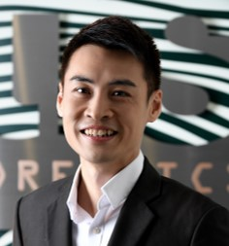
Your Engagement Team
Expertise
Internal audit
Pre-IPO Internal Control Review
Enterprise risk management
Compliance review
Roles Held
Director and Head of Internal Audit at a Top 10 accounting firm
Internal Auditor at a Big 4 Accounting firm
External Auditor at a mid-tier Accounting firm
A Certified Internal Auditor and Chartered Accountant of Singapore, Gary has more than 15 years of experience in internal and external auditing, pre-IPO internal control reviews, Sarbanes-Oxley reviews, enterprise risk management, corporate governance, license compliance and other consulting work relating to risks and internal controls.
Gary’s previous role was the Head of Internal Audit at a Top 10 accounting firm where he managed a portfolio of more than 30 listed companies and led a team of about 20 internal auditors.
Gary has served as the director-in-charge of internal audit for listed companies in the construction industry and has extensive experience in similar industries.
Gary Ng
Director

Slide 32
Your Engagement Team
Expertise
Software design
System architecture
Security controls for proprietary and opensource platforms
Security audit
Roles Held
Technology scout
Security advisor
Penetration tester
Derek has over 30 years working with systems software including software to build/run software, security and robust systems. He has taught software development in undergraduate in the School of Computing, National University of Singapore and post-graduate courses in Institute of Systems Science, NUS.
Derek is an appointed member of IMDA CITREP+ Skills Expert Panel, Security and Software & Applications domains.
Derek Kiong
Director

Slide 33

Your Engagement Team
Expertise
Internal audit
Pre-IPO Internal Control Review
Enterprise risk management
Compliance review
Business Operation
Roles Held
General Manager at a Malaysian company
Internal Auditor at a Top 10 accounting firm in Singapore
As a Certified Internal Auditor and Certified Practising Accountant, Chee Min has over 9 years of experience in internal and external auditing, pre-IPO internal control reviews, enterprise risk management and other consulting work relating to risks and internal controls.
She was involved with various internal and external audit engagements for clients from medium to major listed organisation in diverse industries including hotel management, property development as well as manufacturing with exposures in countries such as Singapore, Malaysia, China, Indonesia and United Kingdom.
Chee Min’s recent role was the General Manager at a company in Malaysia where she was responsible for the company’s strategic development, operations, financial and compliance functions.
Thoo Chee Min
Manager

Slide 34
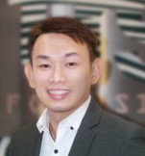
Your Engagement Team
Expertise
Internal audit
Pre-IPO internal control review
Internal control manual development
Enterprise risk management
Forensic Accounting
Roles Held
Internal Audit Assistant Manager at a Top 10 accounting firm in Singapore
Internal Control Advisor at a consulting firm in China
Internal Auditor at a reputable internal audit firm in Malaysia
A Certified Internal Auditor, Vson has over 8 years of experience in internal auditing, pre-IPO internal control reviews, internal control manual development, J-SOX reviews, enterprise risk management and other consulting work relating to risks and internal controls.
Prior to joining TRS Forensics, Vson was an Internal Audit Assistant Manager at a Top 10 accounting firm where he performed risk assessments, developed risk-based internal audit plans and work programmes, executed and/or reviewed the audit work papers, prepared and/or reviewed internal audit reports.
Other than listed companies, Vson has also advised more than 10 SME companies from various industries in the area of internal controls in recent years for purpose of IPOs in Singapore, Malaysia and Hong Kong.
Vson Pua
Assistant Manager

Slide 35

Contact Us
Thank You!
Gary Ng, Director
D: +65 6380 9661
M: +65 9679 1267
garyng@trsforensics.com

